Slide 1
MuleSoft Platform
Integration Architecture
November 20th, 2017

Slide 2

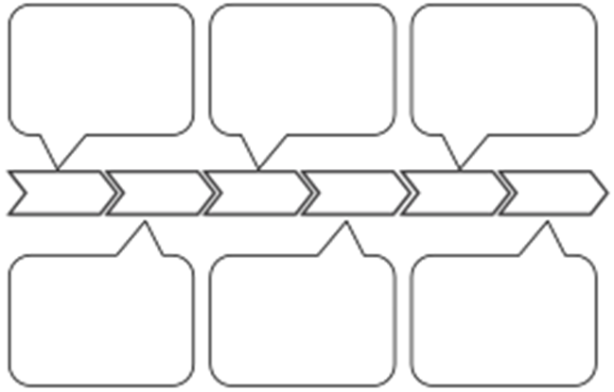
Contents
High Level Architecture On Azure
Security
- Properties File
Security
- Https
CI/CD Requirements
Appendix

Slide 3


High Level Integration Architecture – On Azure
Mulesoft Portal
Application Gateways
Mulesoft Containers using Kubernetes
JENKINS
Maven
Artifactory
API Portal
Exchange
API Management
Mule Run Time Management
SFTP Server
Azure SaaS
eBay On-Prem
Express Route
Mule
(On Prem)
eBay
On-Premise Applications
Scheduler
Service
Bus
JIRA
Key Vault
Container Service
Blob
Storage
Github
Oracle DB on VM

Slide 4



High Level Integration Architecture – On Prem
On-Prem
VM - Dev
Management Server
Mulesoft Containers
Mulesoft Containers
JENKINS,
Mulesoft Portal
VM - QA
Build Server
API Portal
Exchange
Mulesoft Containers
Mulesoft Containers
API Management
Mule Run Time Management
F5
Gate way
VM - Prod
JIRA
Mulesoft Containers
Github
Mulesoft Containers
Azure SaaS
VM - DR
Oracle DB
Mulesoft Containers
Scheduler
Container Service
Service
Bus
Mulesoft Containers
Key Vault
Blob
Storage

Slide 5
API – Connectivity – Kubernetes – On Prem
VM - Master
API Server
Kube-proxy
Serviceip
(iptables)
Process of Defining Load Balancer using Kubernetes Service
Get a list of pods running a given application
Create a service object that exposes the pods
Get ip addresses
  The API Server exposes the services on an ip which is balanced to the container ip internally – using kube-proxy
The API Server associates the service virtual ip to the external ip of the worker node.
Internal 10.32.0.3
VM – Worker Node
Pod-01
External IP 35.197.41.156
Container
Internal Service (VIP)
10.104.13.219
Internal 10.40.0.3
Pod-02
Container

Slide 6
Mulesoft Key Processing – Properties File Processing
VM
Mulesoft Container
Key Vault
Source Code on Github
Seed Key passed from CI/CD Process
Application Initialization
Get Decryption Key from Azure using Seed Key
CI/CD Process
Decrypt Properties in properties file using Key from Azure Key Vault and load in memory
Properties File with Encrypted Properties
Encrypted
Properties File

Slide 7
Mulesoft Https Processing (Inbound) - Current
OAuth Provider
Mulesoft Flow
API Gateway
Https Listener
Validate Token
Token Valid>
Process Request
Process Exception
Present OAuth Token
Return Exception
Return Response

Slide 8
Mulesoft Https Processing (Inbound) – Going Forward
Mulesoft Portal
OAuth Provider
API Management
Mulesoft Integration Server
Present OAuth Token
API Gateway
Forward if authentication is successful
Mulesoft Flow
Download Policy & URL
Https Listener
Process Request
Authenticate

Slide 9
Mulesoft Https Processing (Outbound)
OAuth Provider
Get Token
Mulesoft Flow
Process Request
Https Connector
Service Provider
Present OAuth Token

Slide 10
Access Azure Blob Storage
Azure Blob Storage is a SaaS service that can be used for storing Message payload and other data that requires persistence
Blob storage uses Secure Access Signature (SAS)
Provide restricted access to a container or blob based on tokens to access data
IP – This capability is in preview only and production workloads are not yet supported
protocol
time interval or
rights allowed

Slide 11


CI/CD Process Flow
Azure
Container Engine
Github Code Repository
Build and MUnit Test / Code Coverage
Containerize
K8S
Artifactory
Repository
Jenkins

Slide 12
Appendix

